Slide 1
CMPT 318
Technical Project
Shivanshu Bansal 301386409
Naman Bharti 301386412
SM Shahjiban Munjoreen 301323565

Slide 2
Agenda
Part 1
Introduction
Classification of Data
What is PCA?
Response Variable Selection
Univariate Modeling
Training and Testing
Multivariate Modeling
Training and Testing
Anomaly Detection
Part 2
Introduction
Early Models
Anomaly Detection Systems
Markov Decision Process
Example
Conclusion

Slide 3
INTRODUCTION
Part 1
With the rapid growth of technology and minimal focus on securities and exploitation, we have given tremendous amount of power in the hands of almost the entire habitation of the planet Earth.
In many instances or professions such as journalism and politics this anonymity is required to maintain safety and peace whereas in some, it is a necessity to being about a restoration of peace.
One negative side to anonymity is cybercrime and terrorism where anonymity is the enemy of stability and peace.
A electric grid worker tasked with recognizing suspicious activity in the community may start by monitoring the household electricity consumption of the neighbourhood and then use statistical models such as Hidden Markov Models to detect any anomalies.

Slide 4
Classification of Data
We separated our data into two different sets consisting of weekdays and weekends as people consume electricity in different patterns on weekdays when compared to weekends and vice versa.
After that, we further divided our four-year dataset into two parts: three-year dataset and one-year dataset as three year dataset gives us sufficient data to train our model and one year dataset to test test our model.
The time window chosen from the data was from 6:00 pm to 10:00 pm as people usually return home by 6pm on weekdays and go to bed by 10pm. On weekends, people spend their time in leisure activities around 6pm and go to bed by 10pm.

Slide 5
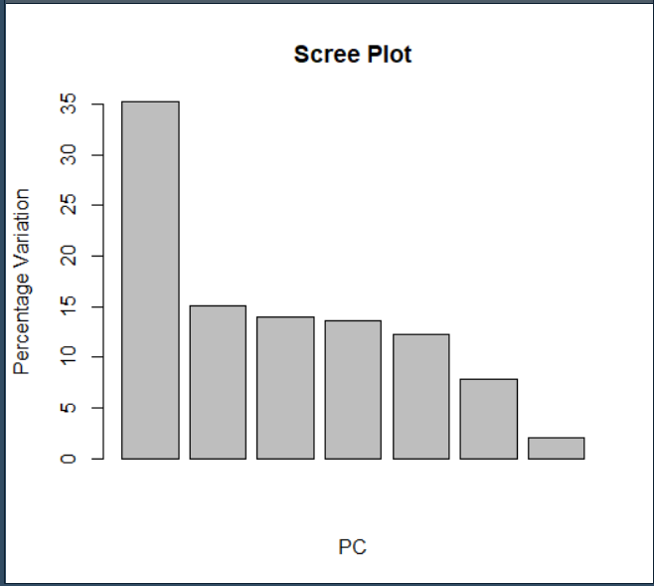
Selection of Response Variables
This method gives us a number for each response variable which tells us how much variance there is for each response variable which helps us to visualize the spread of response variables in our data.
Selection for Weekdays: After using prcomp() function and plotting in R for calculating the PCA of response variables of weekdays, we get the graph

Slide 6
Selection of Response Variables
Selection for Weekends: After using prcomp() function and plotting in R for calculating the PCA of response variables of weekends, we get the following graph

Slide 7
Selection of Response Variables
The graphs of both weekdays and weekends show us that PC1 has the largest proportion of variance and hence it is most likely that the response variables to be chosen will be influenced from PC1.
After doing several calculations, we see that, Global Intensity and Voltage have large numbers when compared to any other response variable from any other PCs.
Therefore, we will take Global Intensity for Univariate modelling and Global Intensity and Voltage for Multivariate modelling for weekdays and weekends.

Slide 8
Univariate Modeling
Univariate time analyses are extensively used in researching the quality of life.
It is also often defined as an analysis of a single variable in order to summarize it and describe its pattern.
For this modeling Global Intensity variable was chosen, as its value in Principal Component 1 is the highest.

Slide 9
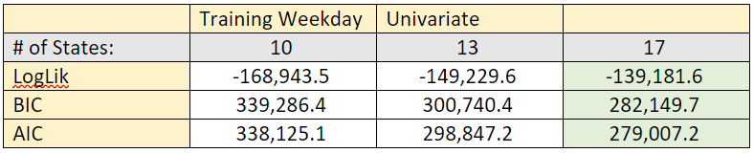
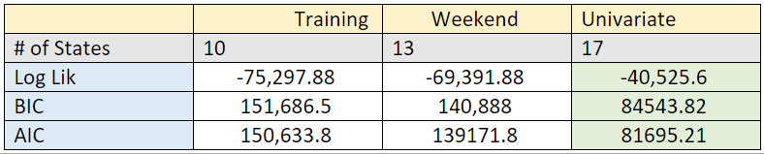
Univariate Modeling
Training & Testing
For the training of our univariate weekdays and weekends model, we chose the number of states to be 10, 13 and 17. We chose these numbers because they provide a good variation between the range of 10 to 20, where it is most likely to get to good fit for our model.
As it can be seen from both the following tables, we get the best balance between BIC and log likelihood from the model that corresponds to 17 number of states. This means that the model from 17 number of states can potentially be a good fit model.

Slide 10
Univariate Modeling
Training & Testing
For weekdays, after normalizing the log likelihoods of both the train and test datasets, we get a difference of 0.005908501 which confirms that the model that we got from 17 number of states is a good fit model.
Similarly, for weekends, after normalizing the log likelihoods of both the train and test datasets, we get a difference of 0.000466885 which ensures that the model that we got from 17 number of states is a good fit model.
These results imply that we can use these models in the future to study different datasets for finding various outcomes such as estimating the number of anomalies in datasets.

Slide 11
Multivariate Modeling
A multivariate analysis is utilized to study datasets that are much more complex compared to what the methods of a univariate model can handle. In fact, it is pretty much impossible for someone to work with such datasets by hand.
Multivariate statistics is also a subdivision of statistics wherein a simultaneous observation and analysis of more than one outcome variable is carried out.
For this model, Global Intensity and Voltage were chosen as the response variables due to their high outcomes in the principal component analysis.

Slide 12
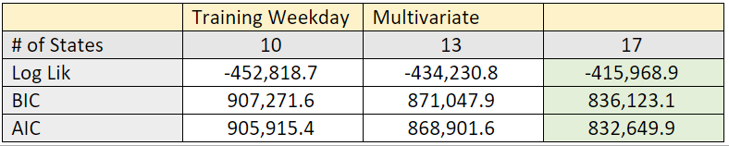
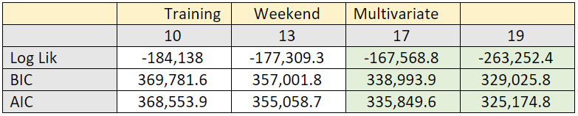
Multivariate Modelling
Training & Testing
For the training of our multivariate weekdays and weekends model, we chose the number of states to be 10, 13 and 17 . We chose these numbers because they provide a good variation between the range of 10 to 20, where it is likely that we can see a good fit of model.
After training for 17 number of states for weekends model, we trained our model for 19 number of states because we assumed that we can get a better balance between BIC and log likelihood for 19 number of states.

Slide 13
Multivariate Modelling
Training & Testing
As it can be seen from both the tables on the previous slide, we get the best balance between BIC and log likelihood from the model that corresponds to 17 number of states. This means that the model from 17 number of states can potentially be a good fit model.
After normalizing the log likelihoods of both the train and test datasets, we get a difference of 0.3178618 for weekdays and 0.3465053 for weekends which ensures that the model that we got from 17 number of states is a good fit model.
Now, we will use the models that we got from multivariate weekdays and weekends modelling to model three datasets so that we can estimate the number of anomalies that are injected in them.

Slide 14
Anomaly Detection
Anomaly detection is about finding patterns in datasets that do not conform to the normal behavior in datasets.
Anomaly Detection can be used for various purposes such as detecting fraud for credit cards, intrusion detection for cybersecurity, military surveillance or counterterrorism.
The method of Log Likelihood was used in detecting anomalies in the datasets. A lower log likelihood indicates that the corresponding dataset contains lesser anomalies compared to the other datasets.

Slide 15
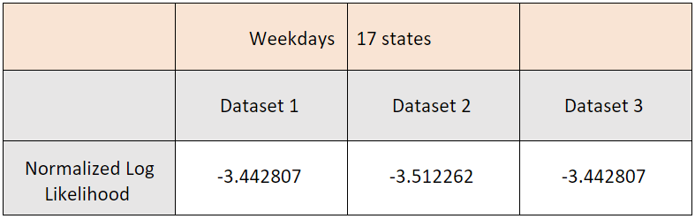
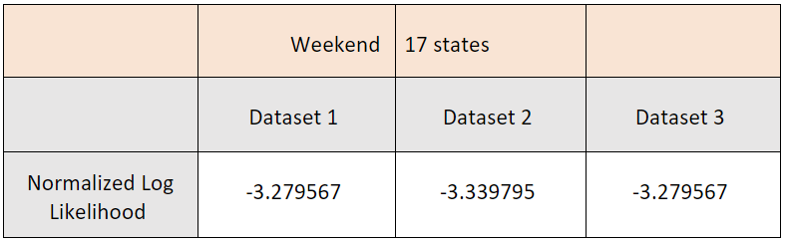
Anomaly Detection
Observations for Weekdays:
Observations for Weekends:

Slide 16
Anomaly Detection
For both weekdays and weekends, it can be clearly seen that the normalized log likelihoods for dataset 1 and dataset 3 are same and the log likelihood of dataset 2 is larger than both of them.
This implies that the degree of anomalies present in dataset 2 is larger than the degree of anomalies present in dataset 1 and dataset 3. It also implies that the degree of anomalies present in dataset 1 and dataset 3 are same.
In the next section, we will learn some more ways for anomaly detection.

Slide 17
INTRODUCTION
Part 2
Intrusion detection is one of the most viable method to defend against complex cyber attacks and computer virus
Intrusion detection consists of developing behaviour models and patterns to detect intrusion
The core problem is to come up with good behaviour models and patterns that will go through large amounts of data and find differences between normal behaviour and unexpected behaviour accurately and efficiently

Slide 18
Early Models
One of the first intrusion detection models drawn by D.E. Dennings was constructed based on the hypothesis that security violations can be spotted by observing a system’s audit records ro irregular patterns of system usage
Since then, researchers have tried to come up with the most effective form of intrusion detection models

Slide 19
Anomaly Detection Systems and Machine Learning
By using machine learning algorithms, adaptive anomaly detection models can automatically be constructed based on labeled or unlabeled audit data
For an anomaly detection system to work, a machine learning model is trained with long lists of normal expected data
With time, the model gets better at identifying anomalies
As security measures get stronger and more sophisticated, criminals must do the same with their attacks to keep up
Training must be continuous for a machine learning model to work in this scenario

Slide 20
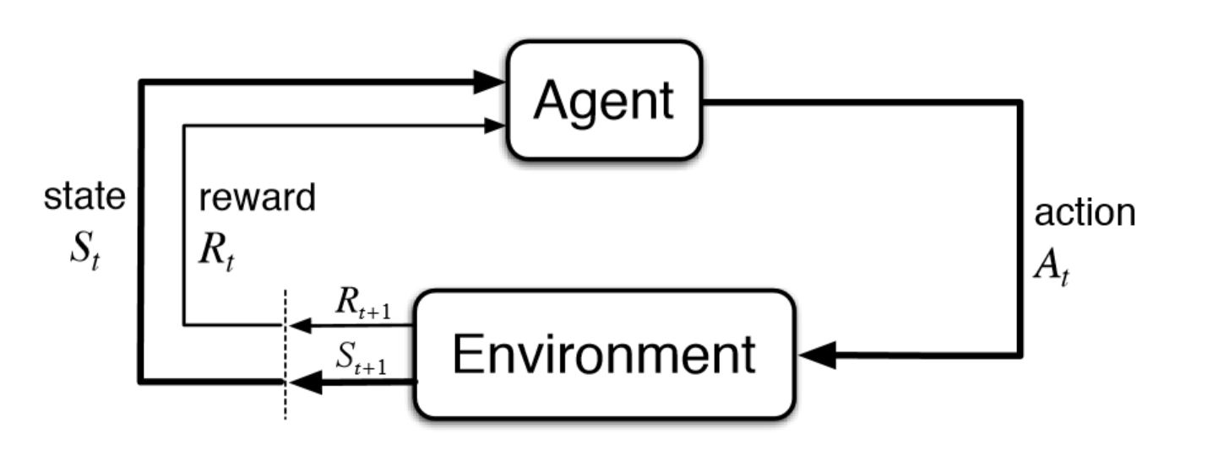
Markov Decision Process
Involves evaluative feedback and an associative aspect - choosing different actions in various situations
Sequential decision making, where actions impact not just instant rewards, but also succeeding situations, or states, and through those future rewards

Slide 21
Example
Self driving school bus that has the job of picking up students from their houses and taking them all to school
The bus’s control system has mechanisms for interpreting sensory information, for traversing, and for controlling the wheels
High level decisions are made by a reinforcement learning agent based on the current charge level of the battery
The agent decided whether the bus should
- actively drive for a certain period of time
- remain stationery for a child to get on or off
- get back to its home base to recharge its battery

Slide 22
Conclusion
A reinforcement learning problem can be modelled in various different ways depending on the level of knowledge primarily available to the agent
Even if the agent has complete and accurate environment model, the agent is usually unable to perform sufficient calculation per time step to fully use it
In most cases of practical interests, approximations must be made because there are too many states than entries can be made in a table

